Slide 1
Customer Churn Analysis Business Analytics Case Study ANALYSTLAB AFRICA DATA ANALYTICS INTERNSHIP
Prepared by
AYOBAMI AJIBOLA
August 2026

Slide 2
Project Objective The objective of this project was to analyze customer churn data to identify factors affecting customer retention and provide data-driven recommendations to improve business performance. Tools Used Python Jupyter Notebook Pandas NumPy Matplotlib Seaborn
Project Overview

Slide 3
Dataset Overview
Dataset Summary
Item | Value
Original Records | 7,043
Cleaned Records | 7,032
Variables | 21
Duplicate Records | 0
Blank Values Removed | 11

Slide 4
Inspected dataset
Converted Total charge to Numeric
Removed blank records
Verified data quality
Data Cleaning

Slide 5
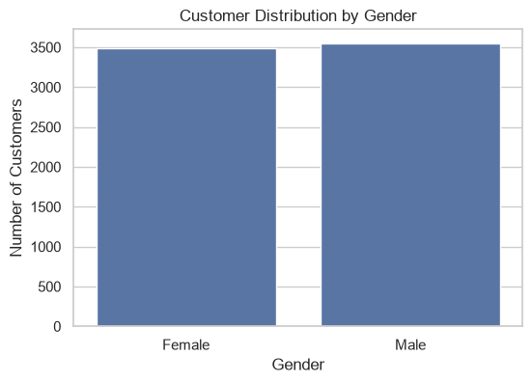
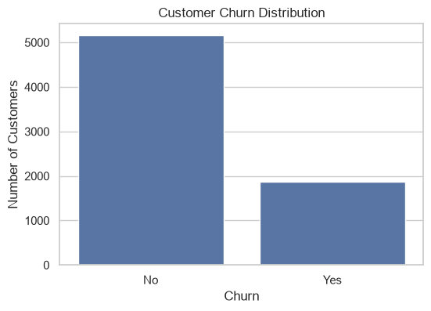
Key Findings Customer base is nearly evenly split between male and female customers. Most customers remained with the company, while a smaller group churned.
Customer Demographics

Slide 6
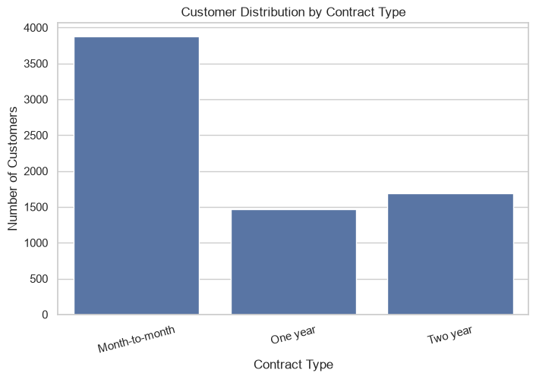
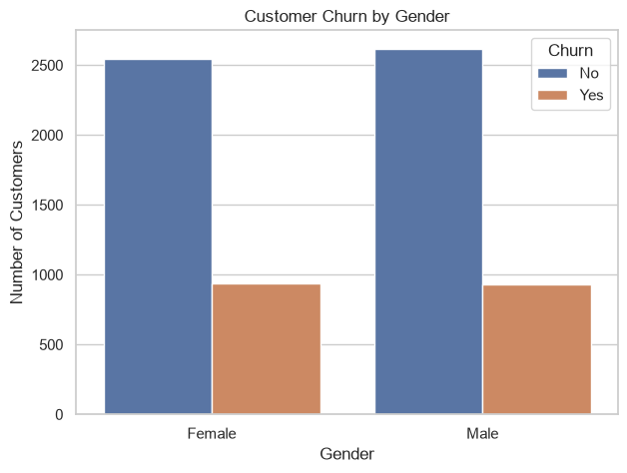
Key Insight Customers on month-to-month contracts experience significantly higher churn than those on one-year or two-year contracts.
Contract Type Analysis

Slide 7
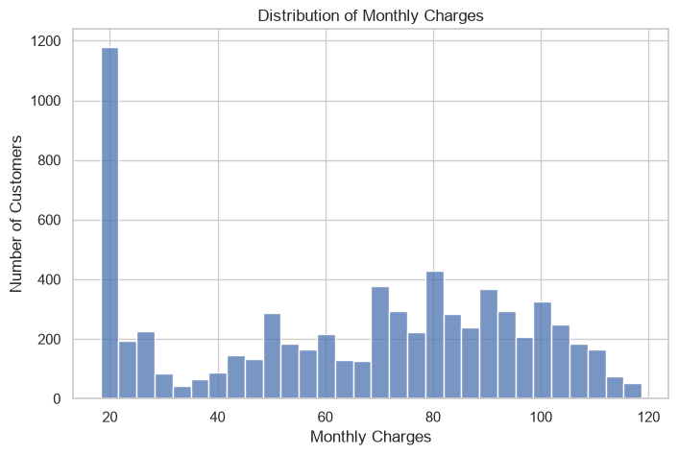
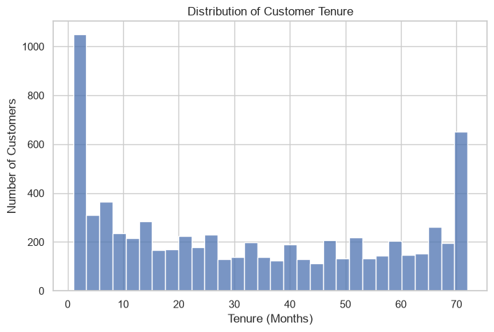
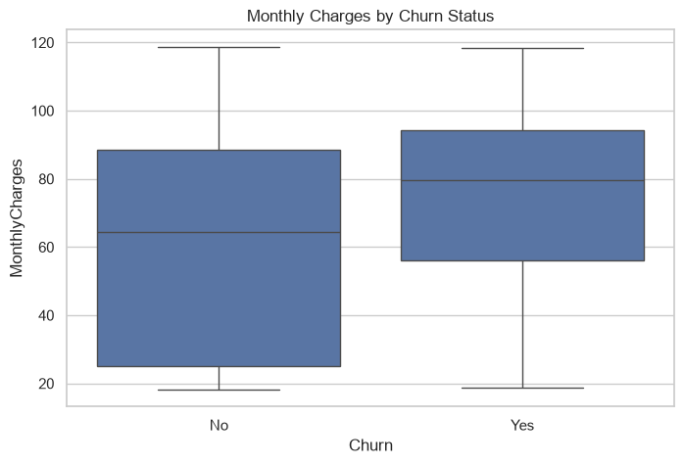
Key Findings Newer customers are more likely to churn. Higher monthly charges are associated with increased churn.
Customer Behaviour

Slide 8
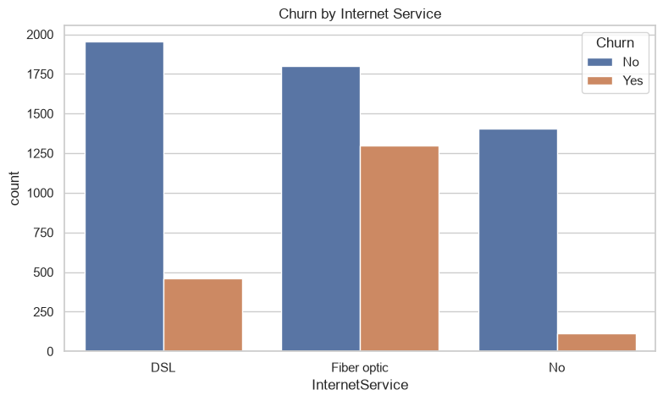

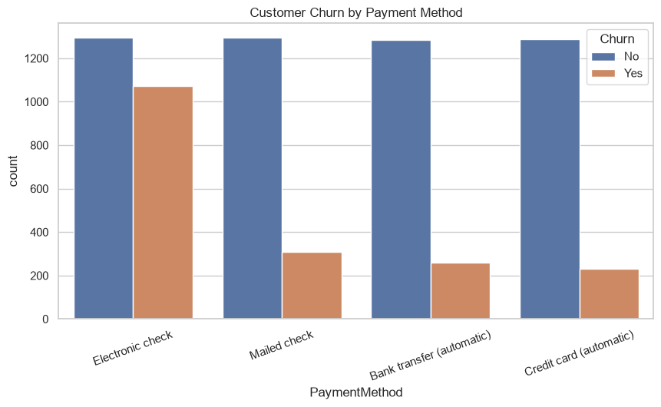
Key Findings Customers without technical support tend to churn more. Electronic check users show relatively higher churn.
Services & Payment Analysis

Slide 9
Key Insights Month-to-month customers have the highest churn. Short-tenure customers are more likely to leave. Higher monthly charges are linked with increased churn. Technical support contributes to customer retention. Long-term contracts improve customer loyalty.
Business Insights

Slide 10
Promote long-term contracts.
Improve onboarding for new customers.
Bundle technical support services.
Review pricing for higher-paying customers.
Encourage automatic payment methods.
Recommendations

Slide 11
The analysis identified contract type, tenure, monthly charges, technical support, and payment methods as key factors influencing customer churn. Implementing targeted retention strategies based on these findings can help improve customer satisfaction, reduce churn, and increase long-term profitability.
Conclusion

